Slide 1
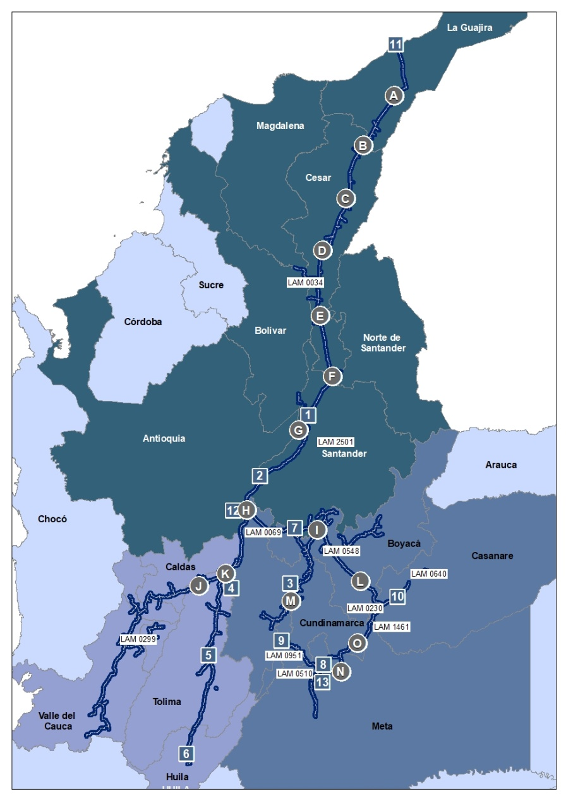
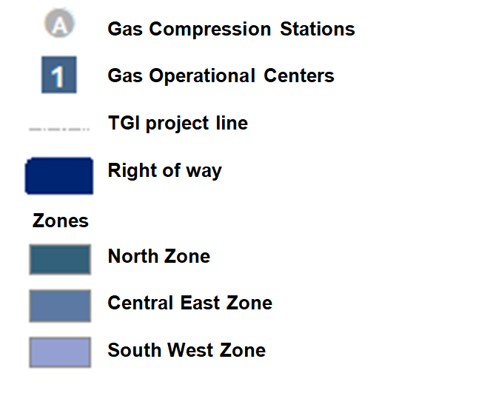
Infrastructure
GAS COMPRESSION STATIONS (ECG)
ID | Name | Area (Ha)
A | ECG1 Hatonuevo | 2,70
B | ECG2 La Jagua del Pilar | 2,98
C | ECG3 Casacará | 2,00
D | ECG4 Curumaní | 2,59
E | ECG5 Noreán | 2,33
F | ECG6 San Alberto | 3,75
G | ECG7 Barrancabermeja | 1,37
H | ECG8 Vasconia | 1,66
I | ECG9 Puente Guillermo | 3,48
J | ECG10 Padua | 3,13
K | ECG11 Mariquita | 2,22
L | ECG12 Miraflores | 1,36
M | ECG13 La Sabana | 1,90
N | ECG Apiay | 2,00
O | ECG14 Villavicencio | 5,80
P | ECG15 Paratebueno | 2,14
GAS COMPRESSION STATIONS (ECG)
ID | Name | Area (Ha)
A | ECG1 Hatonuevo | 2,70
B | ECG2 La Jagua del Pilar | 2,98
C | ECG3 Casacará | 2,00
D | ECG4 Curumaní | 2,59
E | ECG5 Noreán | 2,33
F | ECG6 San Alberto | 3,75
G | ECG7 Barrancabermeja | 1,37
H | ECG8 Vasconia | 1,66
I | ECG9 Puente Guillermo | 3,48
J | ECG10 Padua | 3,13
K | ECG11 Mariquita | 2,22
L | ECG12 Miraflores | 1,36
M | ECG13 La Sabana | 1,90
N | ECG Apiay | 2,00
O | ECG14 Villavicencio | 5,80
P | ECG15 Paratebueno | 2,14
PROJECT INFORMATION
Project | Area DDV (Ha)
LAM0034 | 2356,07
LAM0054 | 702,89
LAM0069 | 2994,19
LAM0138 | 111,83
LAM0230 | 557,46
LAM0278 | 121,66
LAM0299 | 2341,42
LAM0510 | 95,02
LAM0548 | 561,98
LAM0640 | 39,8
LAM0951 | 394,56
LAM1063 | 122,91
LAM1428 | 139,94
LAM1461 | 47,26
10,715 total hectares
10,587 Gas pipelines and right of way
41.42 GCS hectares
86.60 OC hectares

