Slide 1


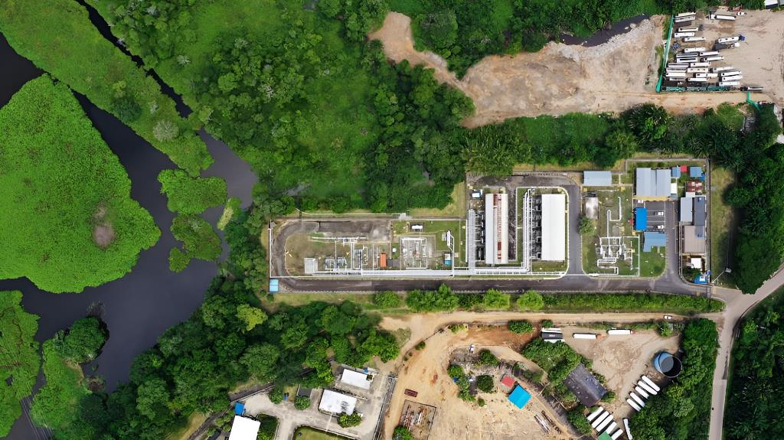

Relevant Aspects of the Climate Change and Energy Efficiency Program.
Headquarters certified in Energy Efficiency under the ISO 50001 standard
Certified Carbon Neutrality sites under the PAS 2060 standard
16
10
Likewise, we promote continuous improvement through the periodic execution of internal and external audits by expert organizations in terms of the Energy Management System and climate change mitigation.

